Slide 1



Algorithm and Problem Classes SIGEVO Summer School 2017
John McCall
Robert Gordon University

Slide 2
Content
Key Questions
Algorithm Classes
Problem Classes
Coherent Problems
Problem Structure
Monotonicity-Invariant Function Classes
Structural Coherence for EDAs

Slide 3
Key Questions

Slide 4
Key Questions
What is the best algorithm to solve a given problem P?
On which problems will algorithm A perform best?
And why?
Mainly addressed through empirical comparison
We can only ever implement a finite set of algorithms and run them on a finite set of problems

Slide 5
Algorithm Classes

Slide 6
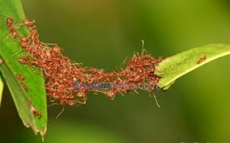
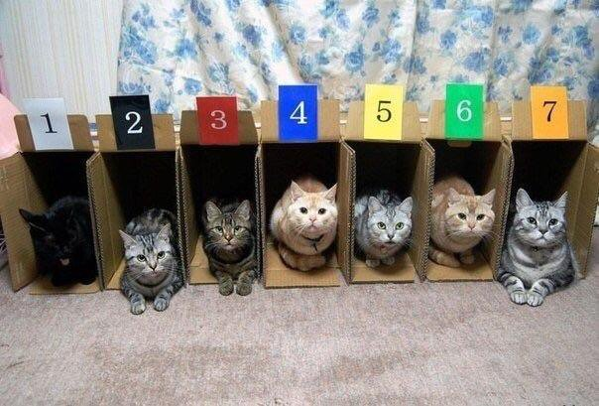
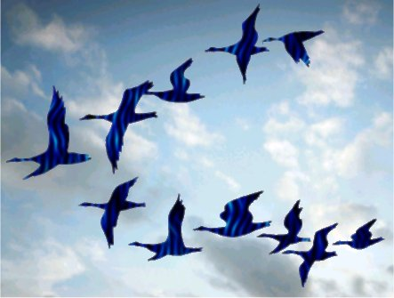
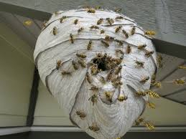
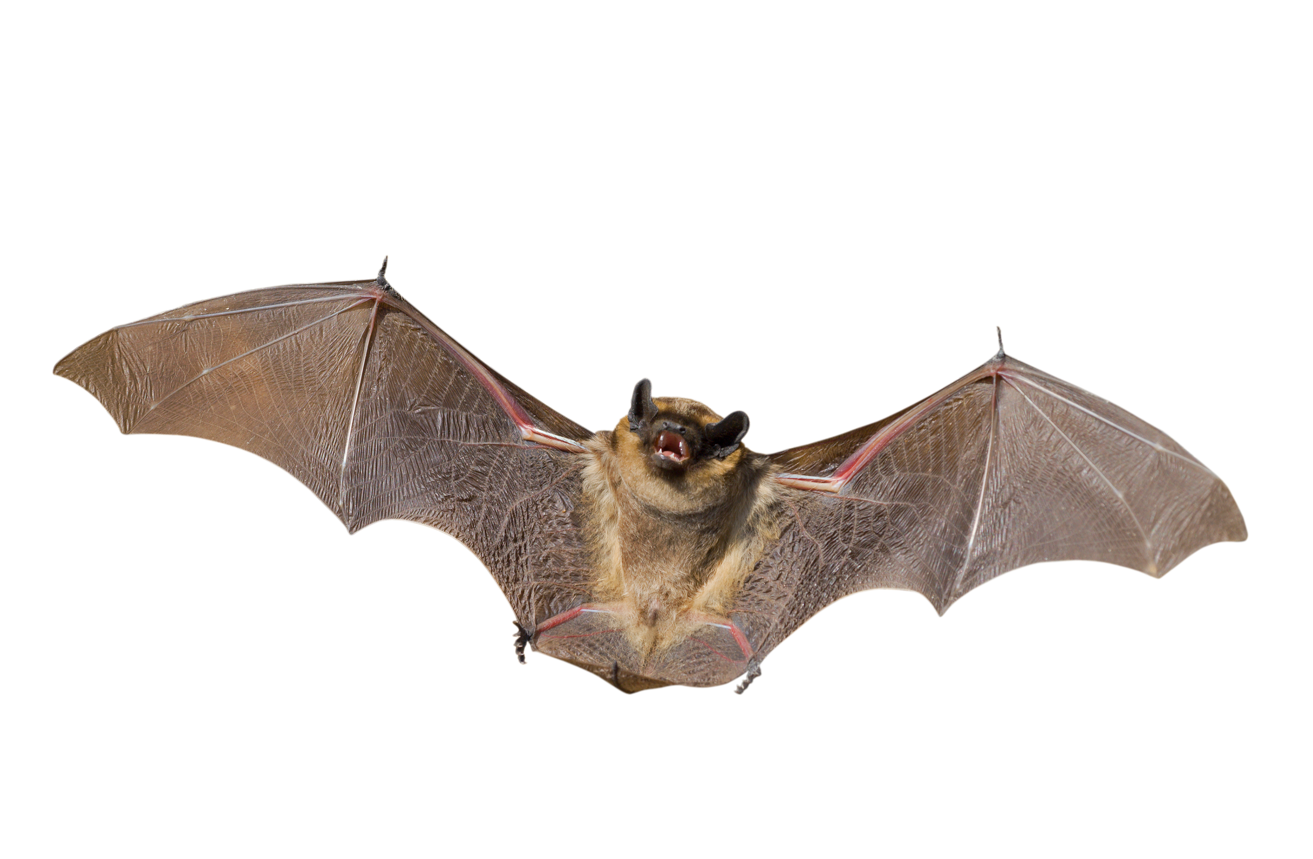
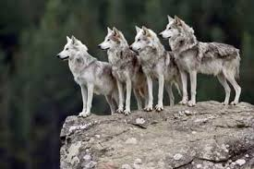
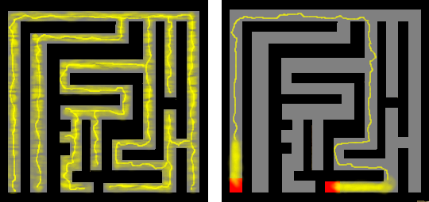
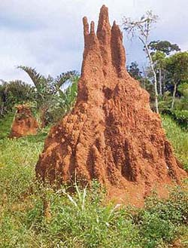

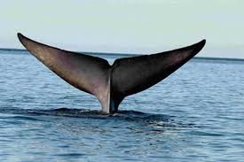
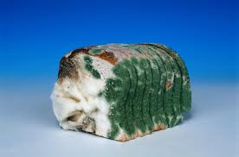
Nature Inspired Algorithms
versatile …
… problem solving
Notes:
Not all AI is inspired by human intelligence.
There are many examples of intelligent behaviour in other natural systems: the flocking behaviour of birds allows huge numbers of individuals to navigate accurately on long journeys only a few of them have ever made; insect colonies are able to construct vast intricate nests no individual could conceive and bridge obstacles no individual could surmount; slime moulds can solve mazes; and genetics produces the vast diversity of life we observe on the planet ranging from bacteria to blue whales, with habitats as diverse as ocean vents, mouldy bread, deserts and cities. Nature is a highly versatile and effective problem solver. The aim of naturally inspired computing is to develop algorithms that solve problems in ways inspired by natural systems as a metaphor. How far we take the metaphor is a matter for academic judgement!

Slide 7
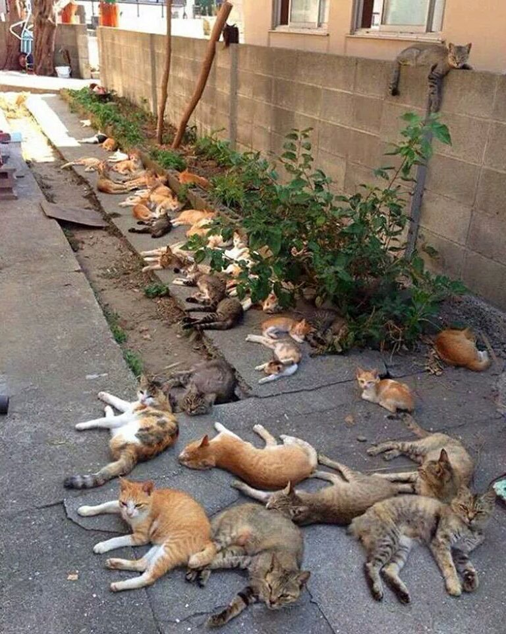

Slide 8
Classification by process: EDA
Estimation of Distribution Algorithm
derived from genetic algorithms
population-based
fitness-driven evolution
learn the distribution of good solutions
memory resides in a probabilistic model
model sampled to produce new solutions

Slide 9
GA vs EDA
initialisation
initialisation
select
parents
select
parents
breed
children
model
parents
update
population
generate
population
completion
completion
GA
EDA

Slide 10
probabilistic models
solution x a collection of random variables
model distribution of x as a j.p.d.
model factorises if all variables are independent
x₁
x₂
x₃
x₄
x₅
x₆

Slide 11
Univariate Marginal Distribution Algorithm (UMDA)
initialise probabilistic model
generate M solutions from the model
select N best solutions
calculate probabilities
re-set the model
stop or return to 2.
0.5
0.5
0.5
0.5
0.5
0.5
0
1
1
1
0
0
1
0
1
1
0
0
0
0
1
1
0
1
0
1
1
0
1
0
0
0
0
0
1
1
1
0
0
0
0
0
0.25
0.5
1
0.75
0.25
0.25

Slide 12
Univariate Marginal Distribution Algorithm (UMDA)
generate M solutions from the model
select N best solutions
calculate probabilities
re-set the model
stop or return to 2.
0.25
0.5
1
0.75
0.25
0.25
1
1
1
1
0
1
1
0
1
1
1
0
0
1
1
1
0
0
0
0
1
0
1
0
0
1
1
1
0
1
0
0
1
0
0
0

Slide 13
Population Based Incremental Learning (PBIL)
initialise probabilistic model
generate M solutions from the model
select N best solutions
calculate probabilities
increment the model
stop or return to 2.
0.5
0.5
0.5
0.5
0.5
0.5
0
1
1
1
0
0
1
0
1
1
0
0
0
0
1
1
0
1
0
1
1
0
1
0
0
0.25
0
0.5
0
1
0
0.75
1
0.25
1
0.25
1
0
0
0
0
0

Slide 14
Population Based Incremental Learning (PBIL)
generate M solutions from the model
select N best solutions
calculate probabilities
increment the model
stop or return to 2.
0.3
0.5
0.7
0.6
0.3
0.3
1
1
1
1
0
1
1
0
1
1
1
0
0
1
1
1
0
0
0
0
1
0
1
0
0
0.25
1
0.5
1
1
1
0.75
0
0.25
1
0.25
0
0
0
0
0
0
UMDA is PBIL with learning rate = 1

Slide 15
univariate model
x₁
x₂
x₆
x₃
x₅
x₄

Slide 16
bivariate model
x₁
x₂
x₆
x₃
x₅
x₄

Slide 17
multivariate model
x₁
x₂
x₆
x₃
x₅
x₄

Slide 18
classification of EDAs
classified by the level of dependency in the probabilistic model
univariate
fully factorised jpd
bivariate
jpd factorises up to pairwise dependencies
multivariate
higher-order dependencies in the j.p.d.
Intended that multivariate EDAs more suitable for problems with many variable dependencies in fitness function

Slide 19
Other Approaches
Hybridisation
Hyperheuristics
Base algorithms controlled by hyper-level algorithm
Automated algorithm construction
Recombine algorithm configurations
Explore parameter space
Operator-free algorithm representations
Search as a Markov chain

Slide 20
The Population Simplex
Vose: population-based search is a trajectory in the population simplex defined by transition matrix
Each vertex is a solution
Each point is a population
Theoretically interesting, practically impossible
EDAs have an explicit model controlling the transition

Slide 21
Assignment 1
Review different approaches used by the community to classify algorithms as represented at GECCO.
Compare and contrast two or more algorithm classes of your choice.
Do algorithms in each class perform consistently over monotonicity-invariant function classes?

Slide 22
Problem Classes

Slide 23
Problem Classes
Classes of problem
Benchmark sets
Schaffer
Rastrigin, Griewank, … etc
Problem types
TSP, FSSP, LOP, QAP, RCPSP, ….
Bin-packing, multiple knapsack, NK landscapes
Application defined
BN learning benchmarks
Various competition sets
Kaggle and other public challenges

Slide 24
Desirable Problem Class Properties
All problems should be classifiable
Class should be well-defined
In a mathematical sense
Notation: class of P denoted as [P]
Class should closely correlate with problem difficulty / algorithm performance
Notation: performance of A on P

Slide 25
Assignment 2
What does the community mean by problem classes?
Review different approaches to defining problem classes as evidenced at GECCO.
To what extent do those problem classes have features or structure that are relevant to algorithm performance?

Slide 26
Coherent Problems

Slide 27
Coherence
R
f
x₂
x₁
Decision Space
Objective Space
(Algorithm)
(Problem)

Slide 28
Coherence
R
f
x₂
x₁
Decision Space
Objective Space
(Algorithm)
(Problem)

Slide 29
Coherence
R
f
x₂
x₁
Decision Space
Objective Space
(Algorithm)
(Problem)

Slide 30
Coherence
The representation metric should be coherent with the fitness metric
Solutions in the representation neighbourhood of the set f⁻¹{s} should often have a fitness in the fitness neighbourhood of s.
A coherent problem should be easy for a maximum ascent hillclimber
f
R
s

Slide 31
Problem Generation
a: Fitness values are assigned to a set of seed solutions in 2D using a minimal spanning tree on Euclidean distance. Fitness is interpolated across the rest of the space, creating a coherent problem by construction
b: An anti-coherent problem is generated from the same set by creating a maximal spanning tree in Step 4.

Slide 32
Results
10,000 coherent and 10,000 anti-coherent bitstring problems, randomly generated up to 100 bits

Slide 33
Assignment 3
Programming exercise: adapt the problem generation method used in [3] to a different representation, for example continuous problems.
Determine whether or not a similar pattern of easy and hard hillclimbing problems can be generated.

Slide 34
Problem Structure

Slide 35
Structure Learning and Optimisation
Problem structure captures how solution variables affect f(x)
Original ideas of linkage, epistasis (Goldberg)
aim to find a useful problem structure:
straightforward to compute
characterises structure essential to the problem
Relates to problem difficulty for given algorithms
supports generalisation across a problem class
Widely studied by EDA community
See also: Gray Box Optimisation
Whitley, Chicano, Goldman

Slide 36
Walsh Structure
The Walsh Structure is the set of subsets k for which α_{k} is non-zero

Slide 37
Walsh Structures on 3-bits

Slide 38
Two Univariate Functions
One Max
Bin Val
Walsh Coefficients

Slide 39
A Bivariate Function
Checkerboard (1-d)

Slide 40
Monotonicity Invariant Function Classes

Slide 41
Monotonicity Invariant Function Classes
R
solutions grouped by function f in M level sets, each taking a real value
functions in equivalence class [f] all rank solutions in the same way
[f] defines set of functions called the problem space P_{[f]}
P_{[f]} is monotonicity invariant
P_{[f]} corresponds to linkage structures in representation space (function basis coefficients)
Infinite set of functions reduced to finite set of function classes.
[f]

Slide 42
Function Class Representation
0
1
1
4
1
4
4
7
Ones function as an instance of C_{ones}

Slide 43
Structures for C_{Ones}

Slide 44
Structures for C_{Ones}

Slide 45
Structures for C_{Ones}

Slide 46
Structures for C_{BinVal} , C_{Check}

Slide 47
Minimal Walsh Structure
Essential structure of P_{[f]} monotonicity invariant.
Many algorithms perform identically across P_{[f]}
P_{[f]}
f
g
path connected

Slide 48
Structural Coherence for EDAs
EDA builds a probabilistic graphical model
bayesian, gaussian, markov, …
EDAs may miss important dependencies or add spurious dependencies
impairs EDA performance
Some dependencies are correct but unnecessary
extra computation for model building
How well does EDA learn minimal Walsh structure?
selection
structure learning
Complete analysis for 2-bit and 3-bit functions

Slide 49
Thank You

